Slide 1

Everything You Need to Know About Chatbots
Presentation by: Pranay Sahare
TE_B_41

Slide 2
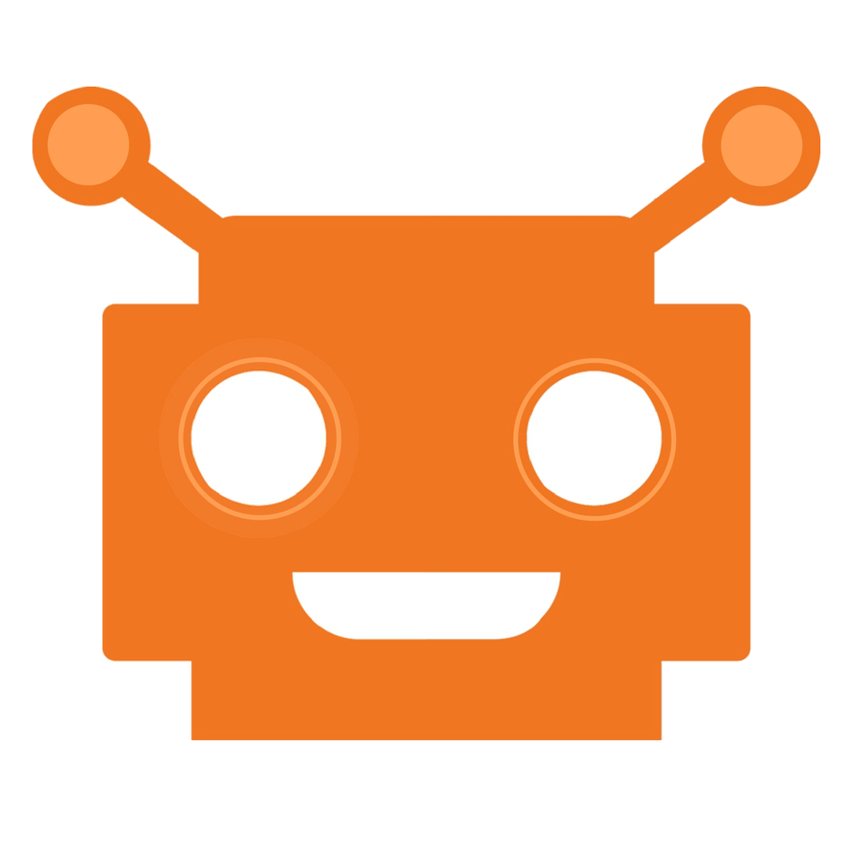
What is a Chatbot?
A chatbot is a computer program governed by a set of pre-defined rules or artificial intelligence that grants it the capabilities to communicate with and like a human.
A set of commands is fed into the system that makes it smart enough to interpret and react to user-inputted queries.

Slide 3
Types of Chatbots
There are two types of chatbots:
#1. Based on a set of rules-
Can be referred to as a pre-programmed bot with limited capabilities. Responds to a specific set of commands and fails to do so if the inputted query does not match the database.
#2. Based on machine learning-
It has an artificial brain that’s powered by AI (Artificial Intelligence). It not just understands commands but a complete language. It learns continually with the conversations of past that eventually makes it smarter and better.

Slide 4








Some of The Chatbots Prominent Today Include The Following:
Types of Chatbots
Weather bot
Life advice bot
Grocery bot
Ticket booking bot
Financial advice bot
News bot
Scheduling bot
And the list goes on

Slide 5
History of Chatbots
The idea of a bot came to light back in 1950 when Alan Turing's article about artificial intelligence was published, called as- “Computing Machinery and Intelligence”.
ELIZA (1966) and PARRY (1972) were the first two chatbots that were intended to understand and simulate human language.
Since then the industry has grown bigger and better especially with the emergence of messenger bots that integrate with platforms like Facebook, WhatsApp, Telegram, WeChat and alike.

Slide 6
How Does Chatbot Work?
A chatbot powered by AI or the one which relies on Natural Language Processing (NLP) combines several steps of code to transform text or speech into structured data, which is then used to generate a relevant response.
This is what happens:
Tokenization- A chatbot bisects the string of words into tokens.
Identification of the entity- Identifies and classifies the words, like a product’s name, a person’s name or an address.

Slide 7
How Does Chatbot Work?
Normalization- Searches for common errors like spelling or typographical mistakes.
Speech identification- Recognizes and understands parts of speech and sentence structures.
Dependency parsing- Recognizes subject, object and dependent phrases in a sentence.
Sentiment analysis- Analyzes the quality of the conversation in regard to a real human.

Slide 8
The future Scope of chatbots
The future of chatbots is that businesses will automate simple payments and allow users to pay directly over live chat or Facebook Messenger apps. The instant process makes the customer happy and improves customer satisfaction. MasterCard has also launched a chatbot, especially for customer payments.

Slide 9
Need of Chatbot?
Widespread use of personal machines
Better Human Computer Interaction
“To express their interest, wishes, or queries directly and naturally, by speaking, typing, and pointing”.

Slide 10
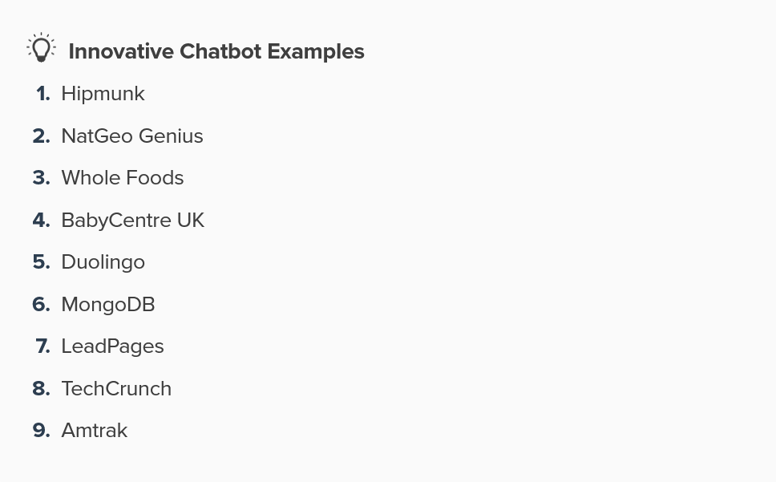
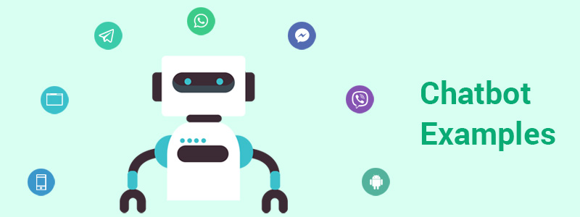
EXAMPLES OF CHATBOTS

Slide 11
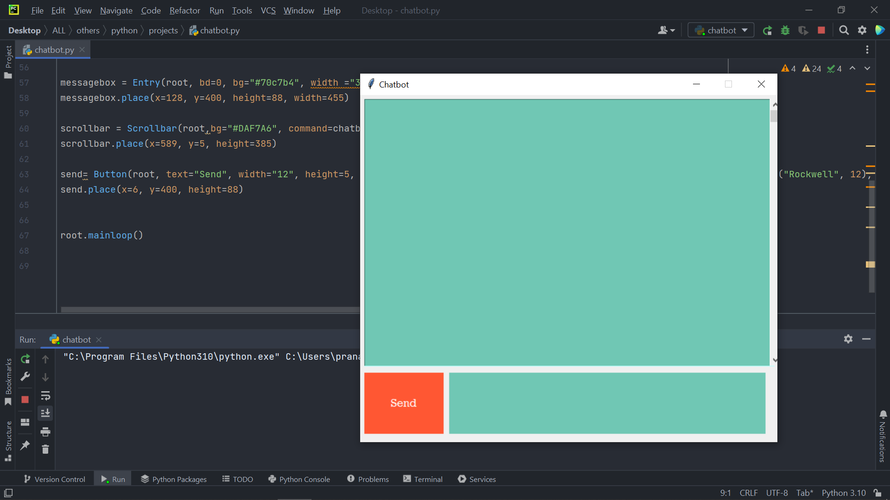
GUI interface of chatbot

Slide 12
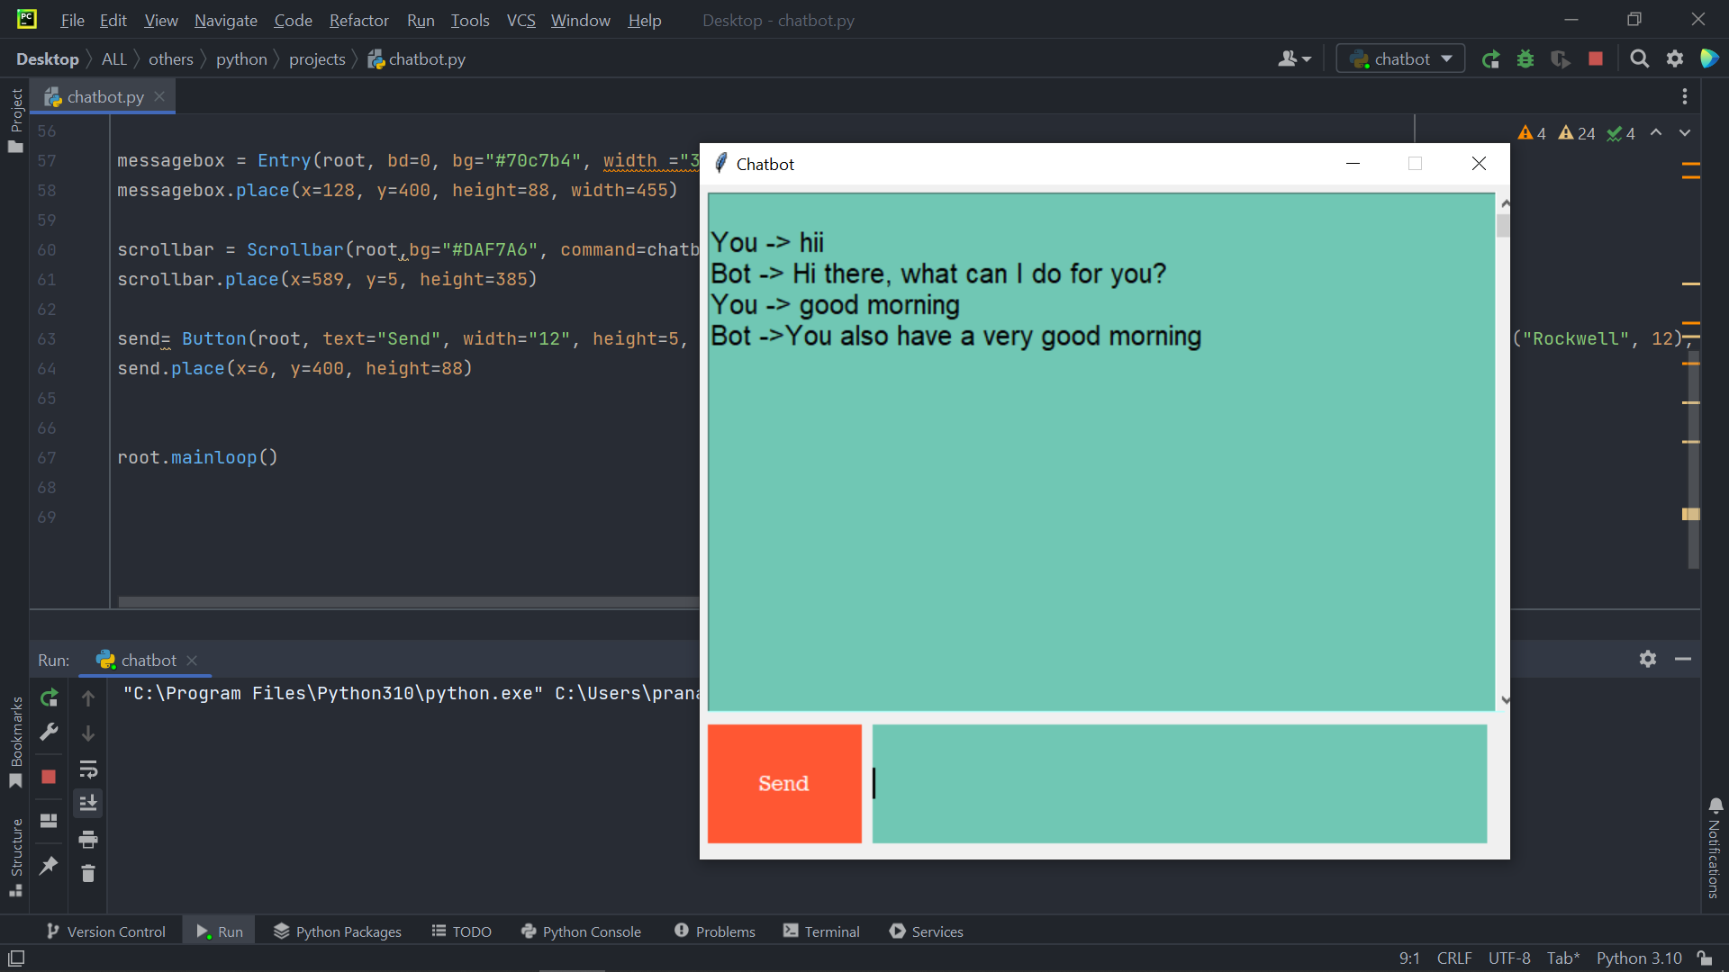
GUI interface of chatbot

Slide 13
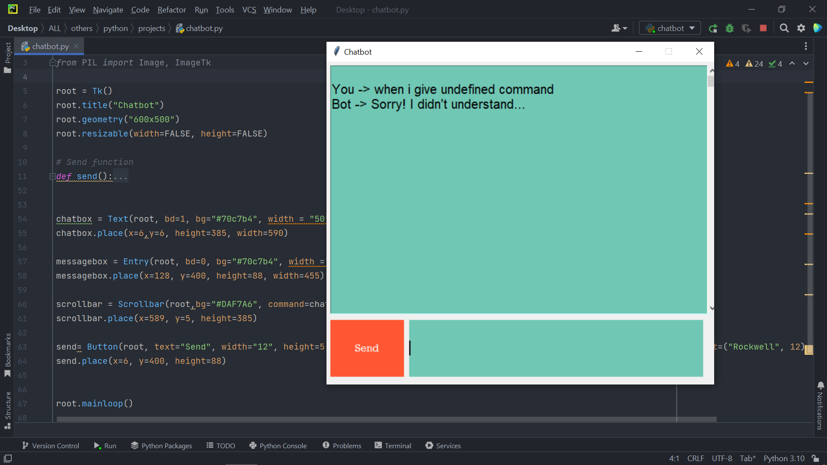
GUI interface of chatbot

Slide 14
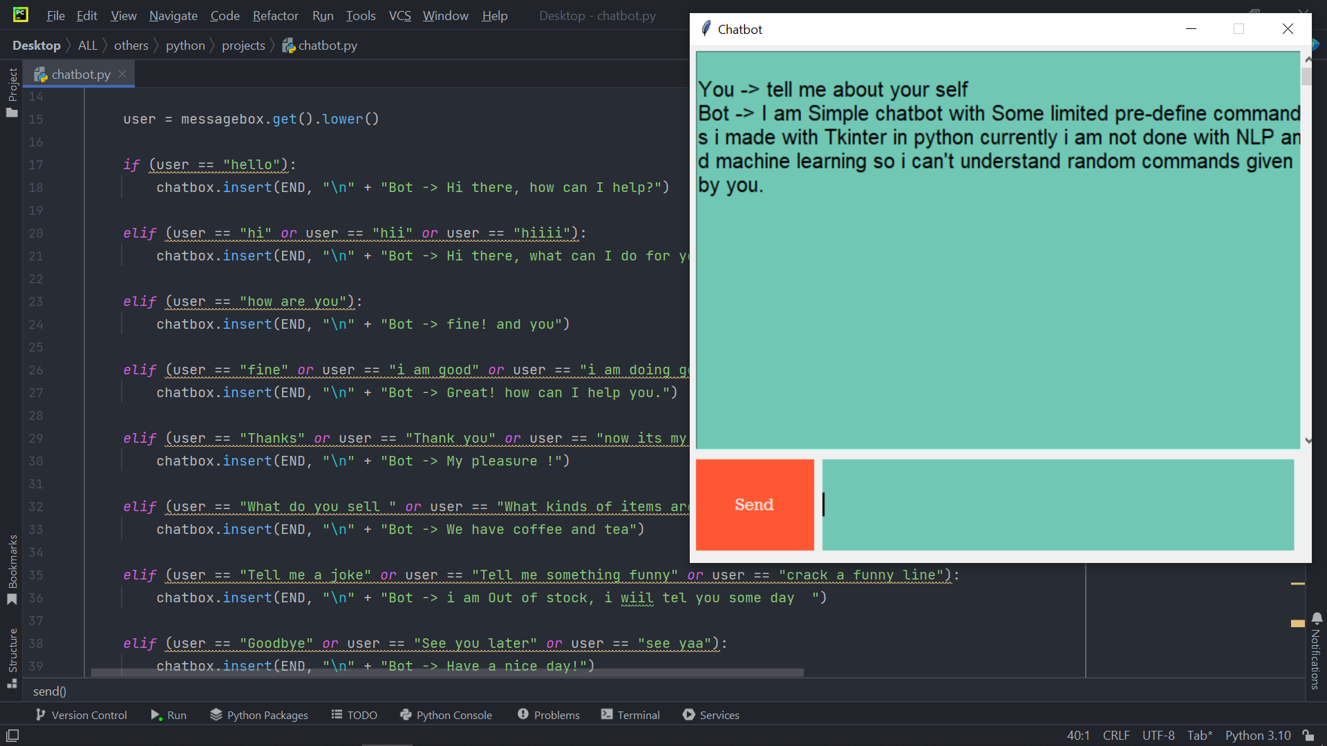
GUI interface of chatbot

Slide 15
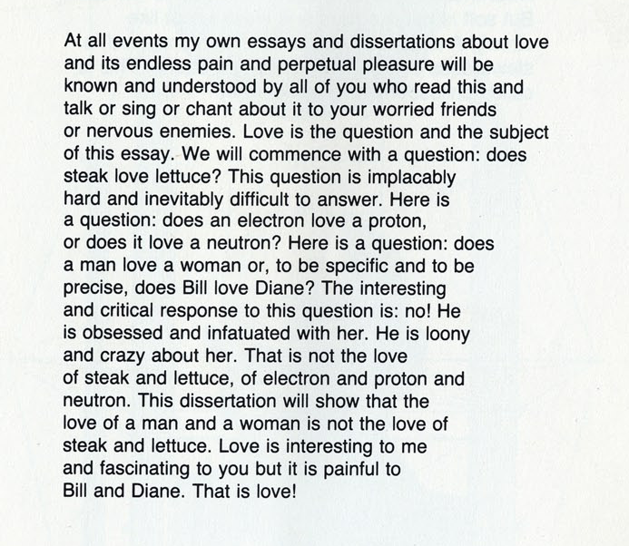
Excerpt from the book

Slide 16
LITERATURE SURVEY OF VARIOUS CHATBOTS
Abstract :
A chatbot is AI computer software that can act as a conversation through textual or auditory methods. The core of chatbots analyses a customer’s data using the artificial intelligence which integrates the response with them. Different tasks can be replaced with AI-powered bots as they are much more powerful—and are capable of performing multiple tasks at once. Machine Learning techniques are basically used in the process of understanding the input that we get from the user and replying to the user. Natural language processing allows a bot to have a conversation as naturally as possible. The ideal interaction between user and chatbot is a balanced mix of Innovative technology and human Intervention
Link :
https://www.jetir.org/view?paper=JETIR200524

Slide 17
References
[1]. A framework for chatbot evaluation. (2017, January 24). Retrieved from https://isquared.wordpress.com/2017/01/24/a-framework-for-chatbot-evaluation.
[2]. An, M. (2017). Artificial Intelligence Is Here-People Just Don't Realize It. Retrieved December 10,2017,from https://research.hubspot.com/reports/artificial-intelligence-is-here
[3]. Ayyar, R. (2017). Now shop with Titan using chatbots-Times of India. Retrieved December 08,2017,from https://timesofindia.indiatimes.com/business/india-business/now
-shop-with-titan-using-chatbots/articleshow/59155840.cms.
[4]. Ballve, M. (2015). Messaging apps are now bigger than social networks. Retrieved December 10,2017
[5].Wikipedia, Google.com, Python.org

Slide 18
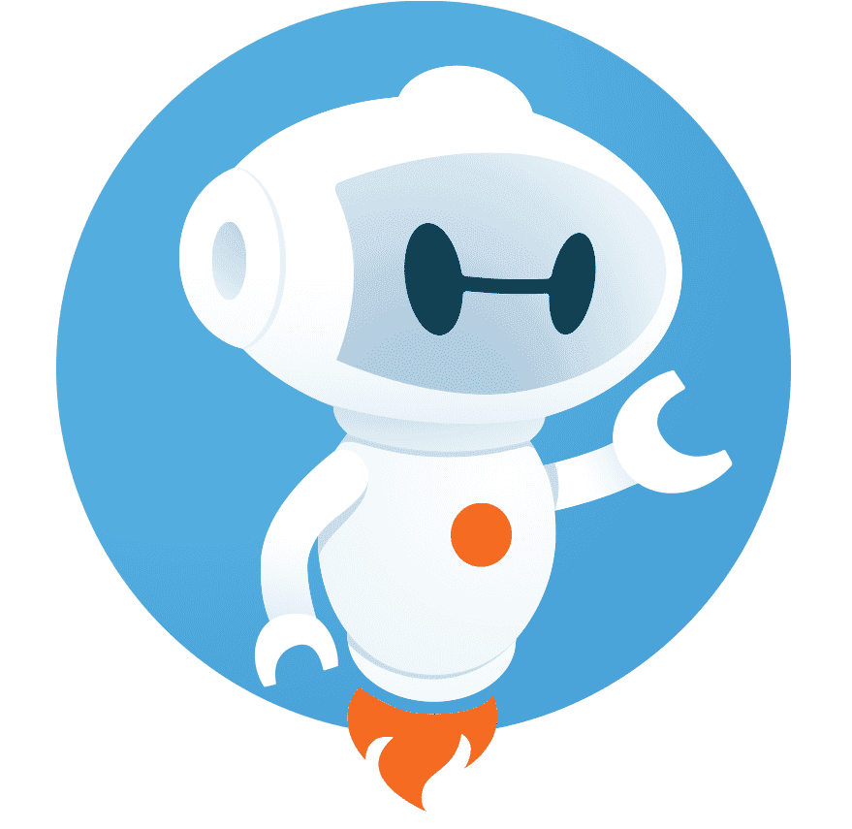
Thank you..

